Slide 1
Hadoop and HBase Introduction

Slide 2
Hadoop and HBase
Hadoop
What is map-reduce?
What is Hadoop?
What is HDFS?
HBase
What are noSQL databases?
What is Hbase?

Slide 3
Map Reduce
Programming model developed at Google
Sort/merge based distributed computing
Initially, it was intended for their internal search/indexing application, but now used extensively by more organizations (e.g., Yahoo, Amazon.com, IBM, etc.)
It is functional style programming (e.g., LISP) that is naturally parallelizable across a large cluster of workstations or PCS.
The underlying system takes care of the partitioning of the input data, scheduling the program’s execution across several machines, handling machine failures, and managing required inter-machine communication. (This is the key for Hadoop’s success)

Slide 4
Word Count Problem
Can we do word count in parallel?
see bob throw
see 1
bob 1
throw 1
see 1
spot 1
run 1
bob 1
run 1
see 2
spot 1
throw 1
see spot run

Slide 5
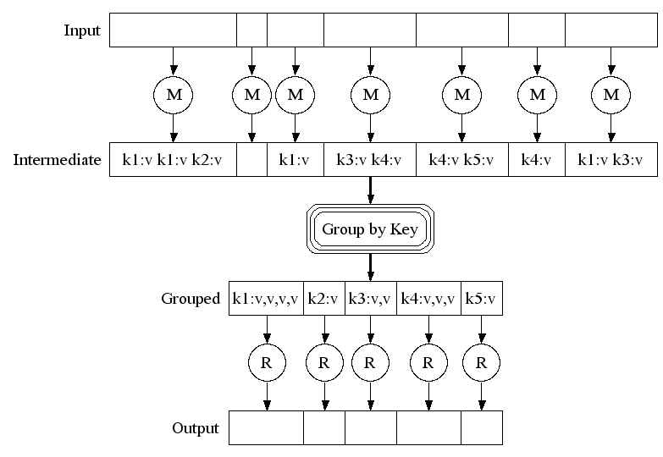
MapReduce Framework

Slide 6
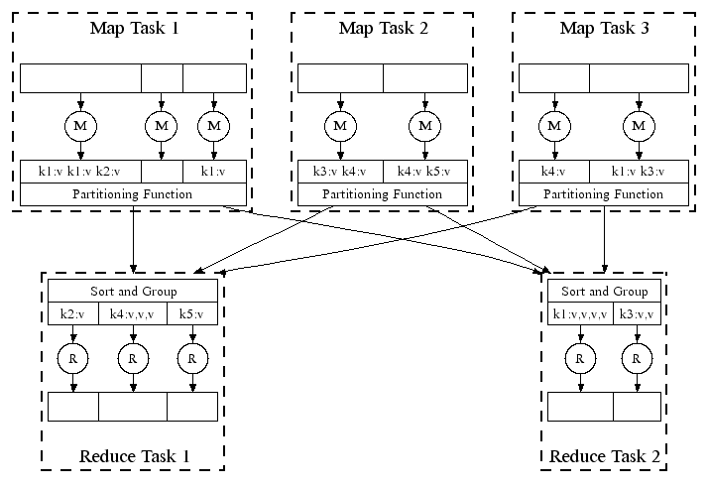
MapReduce Framework 2

Slide 7
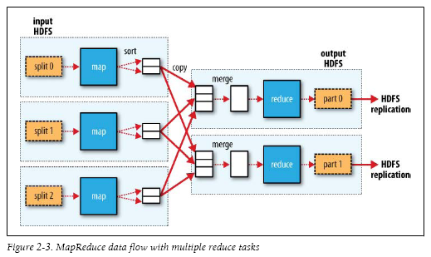
MapReduce in Hadoop

Slide 8
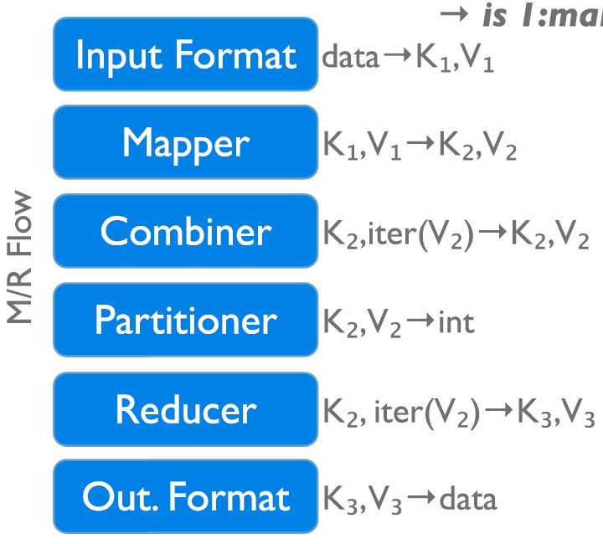
Hadoop Steps
Map function
Shuffling
Partitioner
Sorting
Combiner
Merging
Reduce function

Slide 9
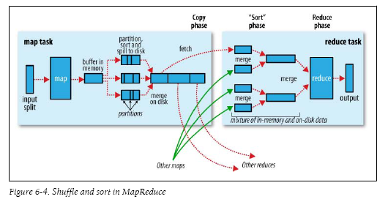
Hadoop Steps

Slide 10
Hadoop System Processes
JobTracker - JobTracker is the service within Hadoop that farms out MapReduce tasks to specific nodes in the cluster, ideally the nodes that have the data, or at least are in the same rack
TaskTracker - A TaskTracker is a node in the cluster that accepts tasks - Map, Reduce and Shuffle operations - from a JobTracker.

Slide 11
HDFS
HDFS (Hadoop File System)
HDFS is the primary distributed storage used by Hadoop applications
designed to reliably store very large files across machines in a large cluster
Inspired by Google File System (GFS)
Notes:
Hadoop's Distributed File System is designed to reliably store very large files across machines in a large cluster. It is inspired by the Google File System. Hadoop DFS stores each file as a sequence of blocks, all blocks in a file except the last block are the same size. Blocks belonging to a file are replicated for fault tolerance. The block size and replication factor are configurable per file. Files in HDFS are "write once" and have strictly one writer at any time

Slide 12
HDFS Features
Data Replication
Simple Coherence Model (write-once-read-many, 64MB blocks)
Replica Selection (while read, rack-aware)
Safemode
Data Disk Failure, Heartbeats and Re-Replication
Cluster Rebalancing
Data Integrity (checksums per block)
….

Slide 13
HDFS Components
HDFS Components
Name Node – software component that manages the meta data for the file system
Data Node – software component that manages the actual storage for the files
Secondary Name Node – explained later

Slide 14

HDFS Architecture

Slide 15
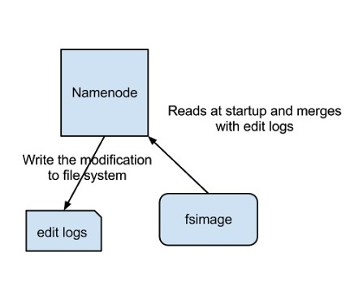
HDFS NameNode
Notes:
The above image shows how Name Node stores information in disk. Two different files are
fsimage - Its the snapshot of the filesystem when namenode started
Edit logs - Its the sequence of changes made to the filesystem after namenode started
Only in the restart of namenode , edit logs are applied to fsimage to get the latest snapshot of the file system. But namenode restart are rare in production clusters which means edit logs can grow very large for the clusters where namenode runs for a long period of time. The following issues we will encounter in this situation
Editlog become very large , which will be challenging to manage it
Namenode restart takes long time because lot of changes has to be merged
In the case of crash, we will lost huge amount of metadata since fsimage is very old

Slide 16
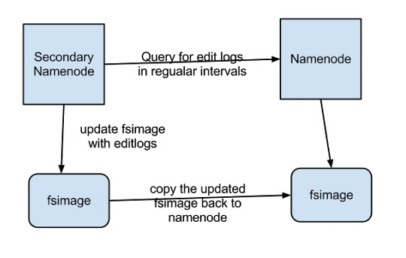
HDFS Secondary Name Node
Notes:
Secondary Namenode helps to overcome the above issues by taking over responsibility of merging editlogs with fsimage from the namenode.
The above figure shows the working of Secondary Namenode
It gets the edit logs from the namenode in regular intervals and applies to fsimage
Once it has new fsimage, it copies back to namenode
Namenode will use this fsimage for the next restart,which will reduce the startup time
Secondary Namenode whole purpose is to have a checkpoint in HDFS. Its just a helper node for namenode.That’s why it also known as checkpoint node inside the community.
So we now understood all Secondary Namenode does puts a checkpoint in filesystem which will help Namenode to function better. Its not the replacement or backup for the Namenode. So from now on make a habit of calling it as a checkpoint node.

Slide 17
NoSQL
Stands for Not Only SQL
Class of non-relational data storage systems
Usually do not require a fixed table schema nor do they use the concept of joins
All NoSQL offerings relax one or more of the ACID properties (will talk about the CAP theorem)

Slide 18
Dynamo and BigTable
Three major papers were the seeds of the NoSQL movement
BigTable (Google)
Dynamo (Amazon)
Gossip protocol (discovery and error detection)
Distributed key-value data store
Eventual consistency
CAP Theorem (Consistency/Availability/Partition Tolerance)

Slide 19
What kinds of NoSQL
NoSQL solutions fall into two major areas:
Key/Value or ‘the big hash table’.
Amazon S3 (Dynamo)
Voldemort
Scalaris
Memcached (in-memory key/value store)
Redis
Schema-less which comes in multiple flavors, column-based, document-based or graph-based.
Cassandra (column-based)
CouchDB (document-based)
MongoDB(document-based)
Neo4J (graph-based)
HBase (column-based)

Slide 20
HBase
HBase is an open-source, distributed, column-oriented database built on top of HDFS, based on BigTable!

Slide 21
HBase Benefits
No real indexes
Automatic partitioning
Scale linearly and automatically with new nodes
Commodity hardware
Fault tolerance
Batch processing

Slide 22
Hbase Data Model
(Column Oriented)
Tables are sorted by Row
Table schema only define it’s column families .
Each family consists of any number of columns
Each column consists of any number of versions
Columns only exist when inserted, NULLs are free.
Columns within a family are sorted and stored together
Everything except table names are byte[]
(Row, Family: Column, Timestamp) → Value

Slide 23
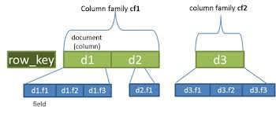
HBase Data Model
(Column Oriented)

Slide 24
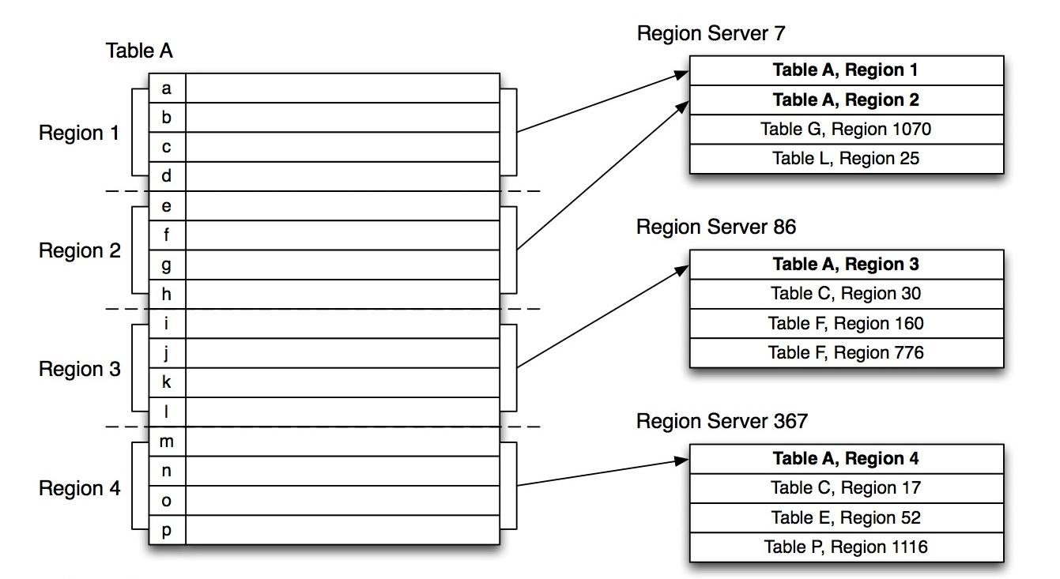
Regions
Regions are the basic element of availability and distribution for tables

Slide 25
Hbase Members
Master
Responsible for monitoring region servers
Load balancing for regions
Redirect client to correct region servers
The current SPOF (single point of failure)
regionserver slaves
Serving requests(Write/Read/Scan) of Client
Send HeartBeat to Master
Throughput and Region numbers are scalable by region servers

Slide 26
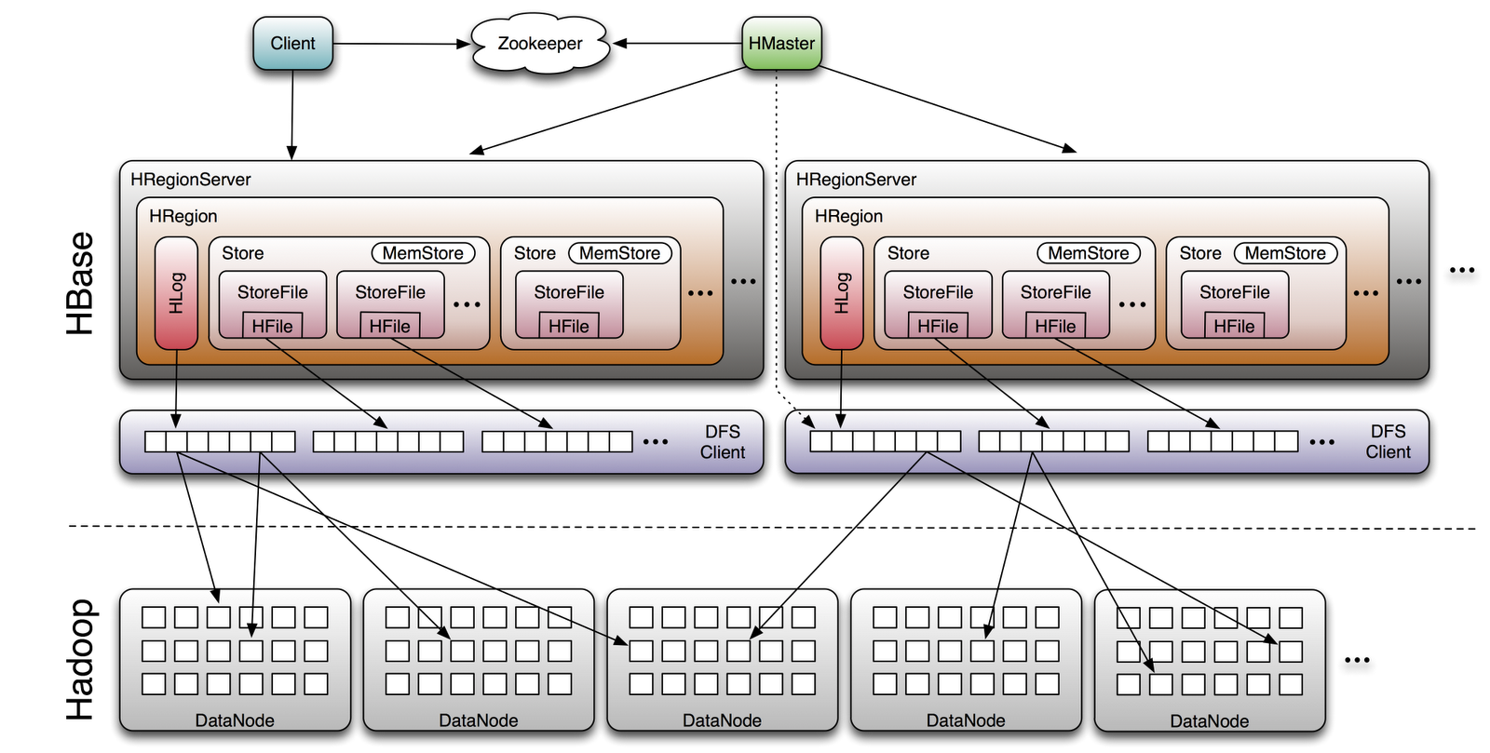
HBase Architecture

Slide 27
ZooKeeper
A highly available, scalable, distributed, configuration, consensus, group membership, leader election, naming, and coordination service

Slide 28
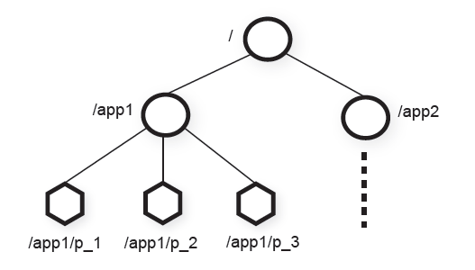
ZooKeeper
Znode
In-memory data node in the Zookeeper data
Have a hierarchical namespace
UNIX like notation for path
Types of Znode
Regular
Ephemeral

Slide 29
ZooKeeper
ZooKeeper Service
Leader
Server
Server
Server
Server
Server
Client
Client
Client
Client
Client
Client
Client
All servers store a copy of the data (in memory)‏
A leader is elected at startup
Followers service clients, all updates go through leader
Update responses are sent when a majority of servers have persisted the change

Slide 30
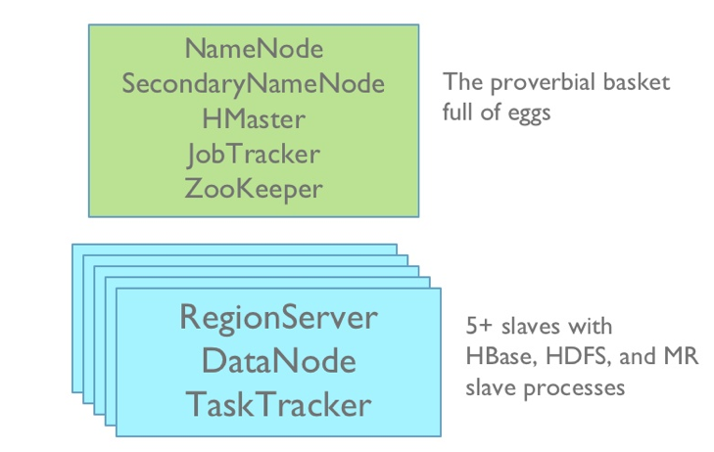

Hadoop/Hbase Deployment
Master
node
Slave
nodes

Slide 31
Questions

